Slide 1
SQL Lesson 20a
Advanced Subqueries
V1.0 2020

Slide 2
Lesson Objectives
After completing this lesson you will be able to
Understand correlated subqueries
Use EXISTS operator with correlated subqueries
Invoke Pairwise comparisons
SELECT from a subquery in the FROM clause
JOIN to a subquery
Invoke the WITH clause for complicated queries

Slide 3
Advanced subqueries
Correlated subqueries
EXISTS operator
Pairwise comparison
Subquery in the FROM clause
JOIN to a subquery
WITH clause

Slide 4
Correlated subqueries
A correlated subquery occurs when the inner query references a column from a table in the outer query.
The correlated, or co-related subquery allows the server to perform row by row processing of the outer query
The subquery is executed once for every row selected by the outer query:
Step 1
Select candidate row from outer query
Repeat
Step 2
Execute inner query using candidate row value
Step 3
Use value selected in inner query to keep or disqualify candidate row

Slide 5
Correlated subquery
The correlated subquery references a column from the outer query.
SELECT column(s)
FROM outer_table
WHERE column_name operator
(SELECT column
FROM inner_table
WHERE column = outer_table.column);

Slide 6
Correlated subquery
Find employees who earn more than the average salary of their job id
SELECT last_name, salary, job_id
FROM employees e
WHERE salary > (SELECT AVG(salary)
FROM employees
WHERE job_id = e.job_id);
Each time a row from the outer query is selected, the inner query is executed through the entire inner table

Slide 7
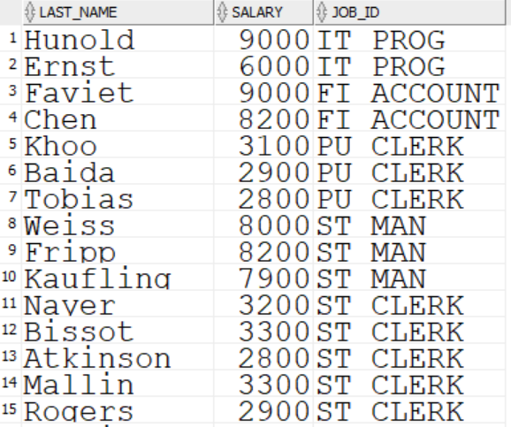
Correlated subquery
Result
…

Slide 8
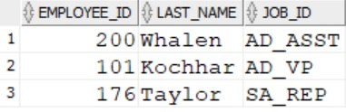
Correlated subquery
Find employees who have changed jobs more than once
SELECT employee_id, last_name, job_id
FROM employees e
WHERE 2 <= (SELECT COUNT(*)
FROM job_history
WHERE employee_id = e.employee_id);

Slide 9
Advanced subqueries
Correlated Subqueries
EXISTS operator
Pairwise comparison
Subquery in the FROM clause
JOIN to a subquery
WITH clause

Slide 10
EXISTS operator
Tests for the existence of a value in the result of the subquery
If the value is found, the subquery stops and TRUE is returned
If the value is not found in the subquery, FALSE is returned
The subquery does not return any table data
EXISTS was originally introduced to make correlated subqueries more efficient

Slide 11
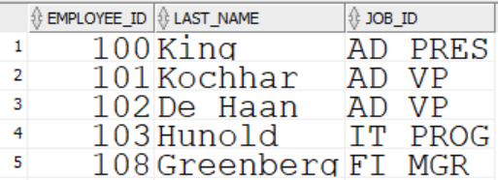
EXISTS operator
Who is a manager?
SELECT employee_id, last_name, job_id
FROM employees e
WHERE EXISTS (SELECT 'x'
FROM employees
WHERE manager_id = e.employee_id);
…

Slide 12
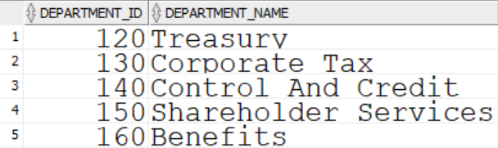
EXISTS operator
Find departments with no employees
NOT flips TRUE to FALSE
SELECT department_id, department_name
FROM departments d
WHERE NOT EXISTS (SELECT 'x'
FROM employees
WHERE department_id = d.department_id);
…

Slide 13
Advanced subqueries
Correlated Subqueries
EXISTS operator
Pairwise comparison
Subquery in the FROM clause
JOIN to a subquery
WITH clause

Slide 14
Pairwise comparison
Correlated subqueries can sometimes be avoided by writing non-correlated subqueries or joins
There are times when pairwise comparison can be used with a non-correlated subquery to return the same data as a correlated subquery

Slide 15
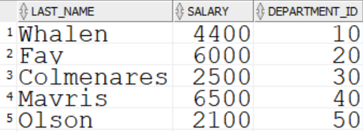
Pairwise comparison
Who earns the lowest salary in their department?
This can be answered using a correlated subquery
SELECT last_name, salary, department_id
FROM employees e
WHERE salary = (SELECT MIN(salary)
FROM employees
WHERE department_id = e.department_id);
…

Slide 16
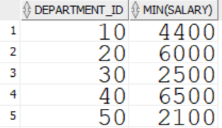
Pairwise comparison
An non-correlated subquery using pairwise comparison can also provide the same result
SELECT last_name, salary, department_id
FROM employees
WHERE (department_id, salary) IN (SELECT department_id, min(salary)
FROM employees
GROUP BY department_id);
Inner query result
…

Slide 17
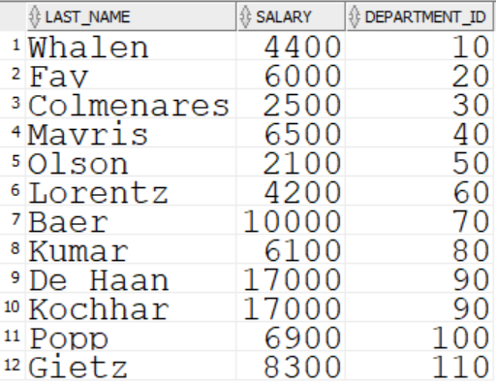
Pairwise comparison
Outer query final result set
…

Slide 18
Advanced subqueries
Correlated Subqueries
EXISTS operator
Pairwise comparison
Subquery in the FROM clause
JOIN to a subquery
WITH clause

Slide 19
Subquery in the FROM Clause
When you SELECT from a subquery, you are selecting from a temporary result set
SELECT AVG(dept_tot)
FROM (SELECT manager_id, sum(salary) AS dept_tot FROM employees
GROUP BY manager_id) a;
The outer query selects FROM “a”
a is a query that is inline, has a name, and represents a result set of data, much like a view
a is known as an Inline View
An inline view is not permanently stored in the database

Slide 20
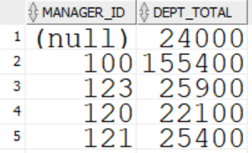
Subquery in the FROM clause
Inline view a creates this result table
…

Slide 21
Subquery in the FROM clause
The outer query merely selects the average of the second column in a

Slide 22
Advanced subqueries
Correlated Subqueries
EXISTS operator
Pairwise comparison
Subquery in the FROM clause
Join to a subquery
WITH clause

Slide 23
JOIN to a Subquery
In this example the departments table is joined to inline view c
SELECT d.department_name, c.city
FROM departments d JOIN
(SELECT city, location_id
FROM locations join countries
USING (country_id)
JOIN regions
USING (region_id)
WHERE region_id IN (3,4) ) c
ON d.location_id = c.location_id
ORDER BY 1;

Slide 24
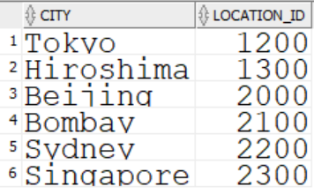
JOIN to a subquery
Inline view c creates this result table

Slide 25
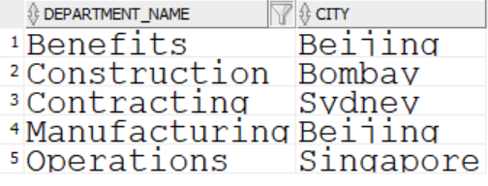
JOIN to a subquery
The result of joining departments table to c inline view is

Slide 26
Advanced subqueries
Correlated Subqueries
EXISTS operator
Pairwise comparison
Subquery in the FROM clause
Join to a subquery
WITH clause

Slide 27
WITH clause
The WITH clause allows complex queries to be broken into smaller blocks
It is useful when joins, subqueries, aggregation, or repeated query blocks are being used
WITH allows you to make inline views which can be repeatedly referenced as needed
The inline views create output that can be used as input to subsequent queries

Slide 28

WITH clause
Suppose you need to find the department names and their total salary for any department whose total salary is greater than the average of all the total salaries by department
The solution could be arrived at without the WITH clause
SELECT department_name, SUM(salary)
FROM employees e JOIN departments d
ON e.department_id = d.department_id
GROUP BY department_name
HAVING SUM(salary) > (SELECT AVG(SUM(salary)) 62218.181818
FROM employees
WHERE department_id IS NOT NULL
GROUP BY department_id) ORDER BY 1;
The WHERE clause removes employee Grant, with a null department_id, from the calculations

Slide 29
WITH clause
Using the WITH clause
WITH a AS (
SELECT department_name, sum(salary) AS totpay
FROM employees e JOIN departments d
ON e.department_id = d.department_id
GROUP BY department_name),
b AS (
SELECT avg(totpay) AS depts_avg
FROM a)
SELECT department_name, tot_pay
FROM a
WHERE totpay > (SELECT depts_avg
FROM b)
ORDER BY 1;

Slide 30
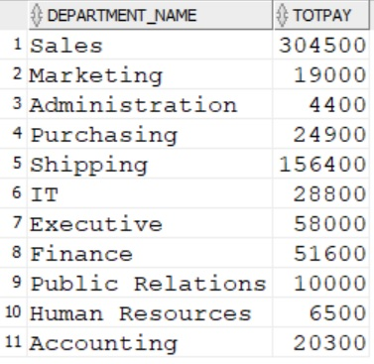
a
b
The final result

Slide 31
Quiz
True or false?
Correlated subqueries reference columns from an outer query table
The EXISTS operator was designed to slow down correlated subqueries
Pairwise comparison allows comparing two values from outer query rows with two values from inner query rows
An inline view is a subquery in the FROM or JOIN
WITH allows complex queries to be broken into smaller parts using inline views as building blocks

Slide 32
Review
In this lesson you learned how to
Understand and use correlated subqueries
Use EXISTS operator with correlated subqueries
Invoke Pairwise comparisons
SELECT from a subquery
Join to subqueries
Invoke the WITH clause for complicated queries

Slide 33
Questions?

